Slide 1
HTML Structure
CTEC 130

Slide 2
HTML Overview

Slide 3
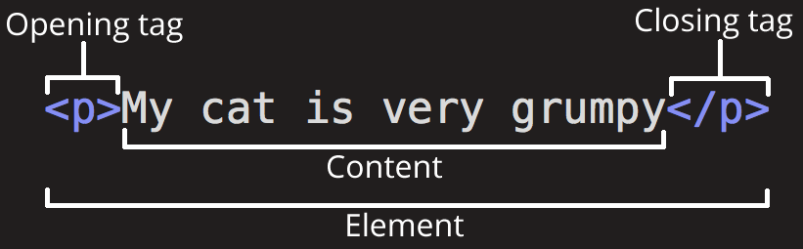
Anatomy of an HTML Element

Slide 4
Element Nesting
Elements can be nested
<p>You’ll see nested elements <em>A LOT</em></p>
Pretty much every element you write will at least be nested in <html> and <body> or <head>
Make sure you close your elements correctly
<p>This is <em>correct</em>, the inner-em tag is closed before the p tag.</p>
<p>This is <em>Incorrect</p></em>
All inner tags should be closed before closing outer tags

Slide 5
Block vs. Inline
Block-Level Element - forms a visible “block” on the page
Displays on a new line by default
Usually structural elements, like paragraphs, lists, headings, navigation, etc.
Inline Element - contained within block-level elements
Provides context or information on content inside of a block
Examples include <img>, <a>, <span>, <em>, and anything that you might put inside of a paragraph instead of next to a paragraph

Slide 6
Empty Elements
Some tags don’t need to wrap-around information, as they’re information in themselves
Like images or line breaks
These are displayed using a single tag
<img src=”moose.jpg” alt=”A Moose”>
No </image> is necessary, and would actually be syntactically incorrect
<br>
Creates a line-break, trying to end it with </br> would accidentally create two line breaks
Notes from an Old Man
There was a time when XHTML was a competing standard to HTML5
In XML-defined standards, empty elements include a / inside
<br/> instead of just <br>
HTML5 ignores this in your tags, so both are valid, but one is the mark of an old fogey who can’t change with the times

Slide 7
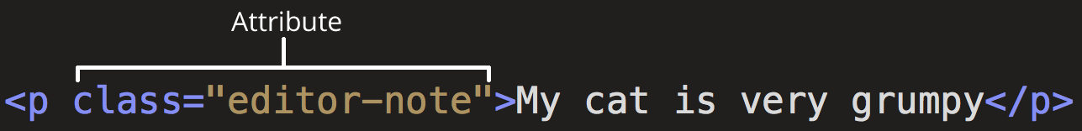
Attributes

Slide 8
Boolean Attributes
Have only one possible value, which is their own name
<input type=”text” disabled=”disabled”>
Here, disabled is a boolean attribute
Can be shortened to just their name
<input type=”text” disabled>

Slide 9
Quotes
You can use Single (‘) or Double (“) Quotes for attribute values
Use whichever you prefer
If you need to use ‘ in the text itself, then use Double Quotes for the value
<img src=”horse.jpg” alt=”Jeremy’s Horse”> - works fine
<img src=’horse.jpg’ alt=’Jeremy’s Horse’> - breaks, browser thinks the attribute ends at ‘Jeremy’
Oh, and these aren’t really quotes
What are generally called single and double quotes are really single and double tick keys on your keyboard
When you write these in a word editor or slide editor, they’ll usually automatically be converted to quote symbols
When you write these in a text editor, they remain ticks
None of the code I’ve written in these slides will work correctly in an HTML document, as Google Slides converts the ticks to fancy-looking quotes

Slide 10
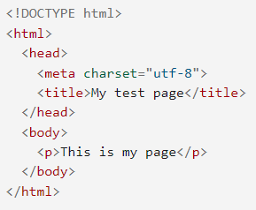
Document Structure

Slide 11
Whitespace
The browser will render any whitespace (spaces, tabs, line breaks) as a single space when displaying
That is, 50 spaces will display as a single space, as will 20 spaces, a tab and a return
Any whitespace outside of tags that display text just doesn’t display at all
Use this to your advantage to organize your HTML source code
Best Practices:
Indent HTML elements to show which elements contain others more easily

Slide 12
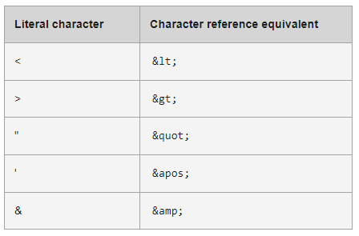
Special Characters

Slide 13
Comments
Start with <!--
End with -->
Anything inside of a comment will not render in the browser, but will stay in the source code

Slide 14
The <head>

Slide 15
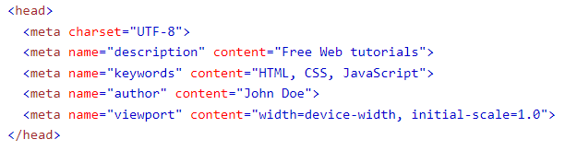
What’s Metadata?
Data about data
Tells the browser about what the content of your page is
Title, description, character encoding, author, keywords, junk that robots might want to know
You can include metadata in your site with one or more meta tags

Slide 16
Favicons
The little icon next to the web address or on the tab in your browser
Short for “Favorites Icon”
To add a Favicon:
Save an image as favicon.ico
Store the image in the same directory as your site’s index.html page
Add this inside the <head> of your pages:
<link rel=”icon” href=”favicon.ico” type=”image/x-icon”>

Slide 17
Linking CSS
This is more of a note for the future, as you’ll have more use for it when you’ve worked with CSS
To link a CSS file to an HTML document:
Create a .css file using a text editor (we’ll worry about this later)
Store the file in the directory with your site
Add a link in your <head>
<link rel=”stylesheet” href=”my-css-file.css”>

Slide 18
HTML Text Fundamentals

Slide 19
Paragraphs
Implemented with <p>
You’ll probably write a bunch of these

Slide 20
Headings
Define a Title or Heading for a section of content on your page
Have 6 levels - <h1> to <h6>
<h1> is for the most important information, <h6> for the least
Make sure you don’t mix your headings

Slide 21
On Semantics
You can make any tag in your HTML look like anything you want with CSS, so why worry about specific header levels, or headers at all?
Robots
Accessibility
Understandability

Slide 22
Lists
Ordered List - the order matters, will be numbered by default
<ol> <li>This is item one</li> <li>This is item two</li> </ol>
This is item one
This is item two
Unordered List - the order of the items isn’t important, will use bullets by default
<ul> <li>This is item one</li> <li>This is item two</li> </ul>
This is item one
This is item two

Slide 23
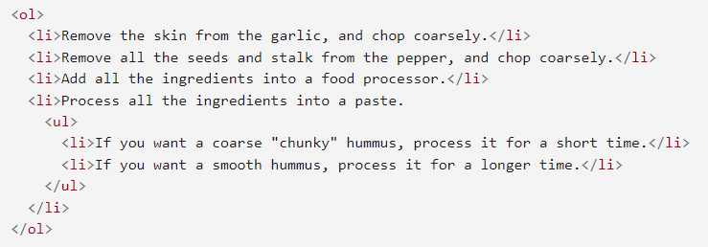
Nesting Lists

Slide 24
Text Decoration
HTML5 is no place for “style,” so traditional bold, italic and underline rules are controversial
<b>, <i> and <u> were part of earlier HTML revisions before CSS and have been grandfathered into HTML5
Even so, they should be used “semantically” or not at all
For example, not to bold text, but to surround text that should be understood in the same way bolded text would be
Other tags are more well regarded:
<strong> - represents text with high importance, bolded by default
<em> - represents text to be emphasized, italicized by default

Slide 25
Hyperlinks

Slide 26

Creating a Link

Slide 27
Neat Link Info
The <a> tag can surround other tags, including block-level tags
<a href=”https://zombo.com”><img src=”moose.jpg” alt=”Moose Image Link” ></a>
Creates a picture of a moose that takes you to zombo.com if you click on it
This is often used to create more stylized navigation links
The title attribute provides extra context if the user hovers the mouse over the link
<a href=”https://zombo.com” title=”Zombo com, anything is possible”>Zombo</a>
This doesn’t work well for users who don’t use mice or have screen readers, so don’t use it for important information
You can create email links as well
<a href=”mailto:sturner@bpcc.edu”>Email Me</a>
This works differently depending on the browser/OS, but will likely open up the default mail program

Slide 28
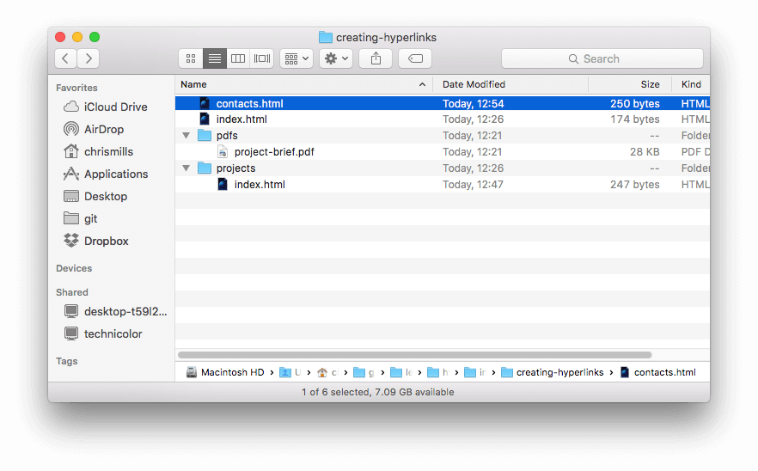
File Structure and Links

Slide 29
Relative vs. Absolute
Absolute Links
<a href=”https://www.bpcc.edu/current-students/student-handbook/index”>Student Handbook</a>
Provide the full URL for the link
Work the same in any location
Relative Links
<a href=”current-students/student-handbook/index”>Student Handbook</a>
Provide the location for the link relative to the current page
Will only work if the relationship is correct
For the above to work, the directory this page is in must also have in it the current-students folder, and so on.

Slide 30
Document Fragments
Links can also take you to a different section of the same page
To create a Document Fragment:
Add an id attribute to the tag you want to link to
<h1 id=”cooldudes”>Cool Dudes</h1>
The id attribute is also useful with CSS and Javascript, but we’ll talk about that later
Create a link with the href=”#yourid”
<a href=”#cooldudes”>Go to Cool Dudes section</a>
This can also be added to the end of another page link:
<a href=”coolpage.html#cooldudes”>Go to Cool Dudes section of Cool Page</a>

Slide 31
Link Best Practices
Use clear link wording
Be descriptive when linking non-html content
Use the download attribute when linking to a download

Slide 32
Images

Slide 33
The <img> tag
Two required attributes
src - the location of the image to display
alt - alternative text for the image
Can use width, height and style attributes to control display of image
<img … width=”400” height=”300”>
Defining these help the page understand where everything should go while its loading
<img … style=”width:500px;”>
This does something similar, but by using in-line CSS rules
The src attribute works like href for a link
You can link to external sites, but this is bad practice

Slide 34
Quotations

Slide 35
Some Quotation Tags
<blockquote></blockquote>
Contains quoted text
Can include a cite attribute with a source link, though that may not display on the page
Is displayed indented by default
<q></q>
A short quote for in-line quoted text
<address></address>
Contains address information
<cite></cite>
Contains the title of a creative work
Many of these are semantic tags that apply default styles that can be overwritten

Slide 36
Structure

Slide 37
Semantics and the Old Days
Before HTML5 we didn’t really have semantic tags
Block-level sections were surrounded in <div>
In-line sections were surrounded by <span>
These tags are still used, but are supplanted in many instances now by semantic tags
Semantic tags can describe document structure
<main>
<article>
<section>
<aside>
<header>
<nav>
<footer>

Slide 38
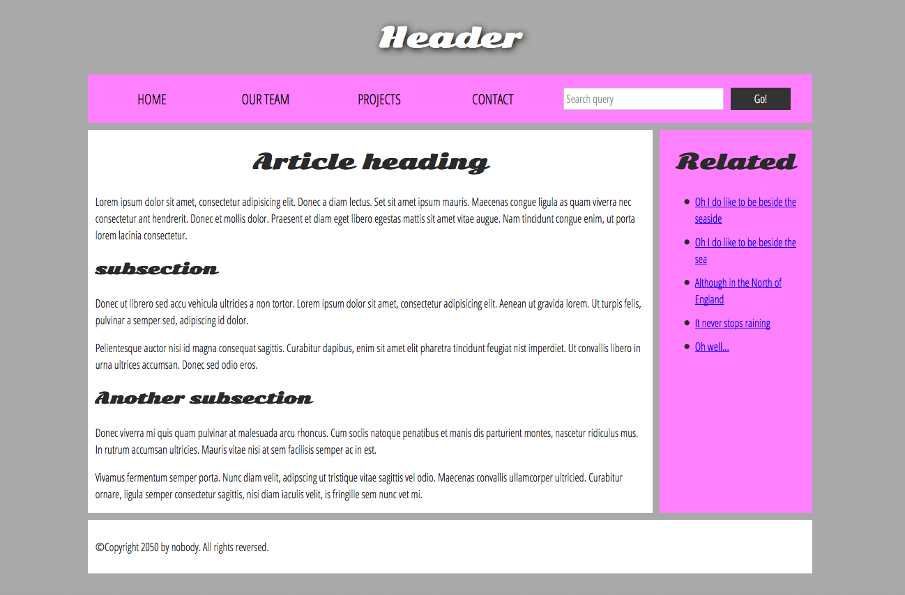
Page Section Example (via CSS)

Slide 39
Semantic Tags in More Detail
<main>
contains main content of the page, should be used only once per page
<header>
If just in the <body>, represents the top section of a page
If in an <article> or <section>, represents the heading of that section
<article>
A block of content, such as several paragraphs that make up a news story
<section>
A smaller amount of content than an article
<aside>
Additional content not necessary for the main content
<nav>
The home of the page’s navigation
<footer>
For the stuff that usually displays at the bottom of a web page

